Slide 1
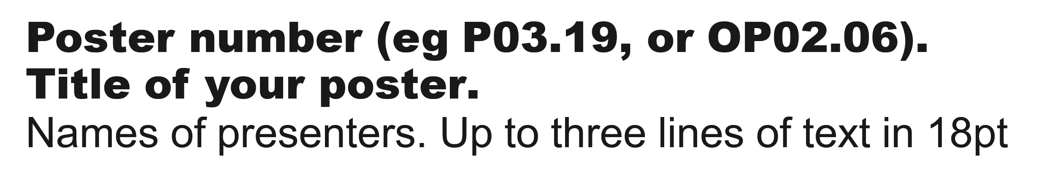
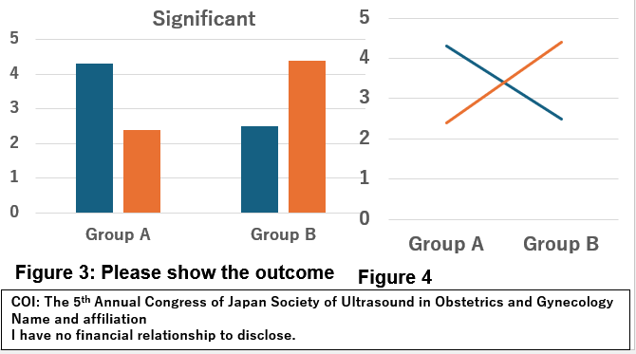
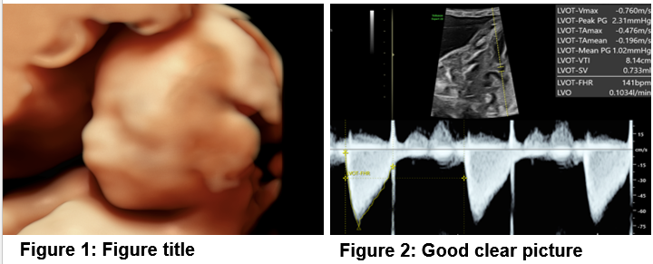
The 5th Annual Congress of Japan Society of Ultrasound in Obstetrics and Gynecology
Conclusion
For many congress participants, the `conclusions` may be the most important element of a poster. You may feature this part with a larger type size or make it obvious!
Introduction
Pictures & Videos
You have just one slide in which to present your poster,
Be concise and remember “Keep it simple!”.
This template gives one of example for your poster presentation.
All kinds of images (JPG, TIF, BMP, etc.) are fine. If you want to use upload video, you can also use them, but please make sure that the videos are playing correctly before submitting your presentation.
Please anonymize the personal information.
Typography
Any easy-read-typeface can be used in your poster
But “fussy” fonts should be avoided.
This template uses “Arial” in 12 pt or more: you should use no less than 9 pt. Use a slightly larger type-face for the subtitles and clear spaces between blocks of text.
Use color sparingly.
Tables or graphs?
You will explain this poster in 3 min!
Diagrams are faster for your audience to take in than tables. Try to convert your data to simple diagrams.

